Slide 1
NBAC TSC Slides 25 April 2024 Meeting

Slide 2
25 April 2024 NBAC TSC Agenda
1:00 NBAC Co-Chair Opening Remarks – Mr. Kamran Atri, Mr. Thomas Krul
We are beginning planning to support the NIEMOpen Reveal (symposium) targeted for 18-20 Feb 2025 at the National Press Club
Draft agenda (pgb brief, back-up slides)
Reveal website & registration coming soon
SAVE-THE-DATE 18-20 Feb 2025, Washington DC
Plan on attending and highlighting your organizations accomplishments during panel discussions
Have your organization consider sponsorship of the event and set up a table at the event – contact Jane Harnad jharnad@oasis-open.org
PGB members and Domain Space Sub-Committees representatives encouraged to attend and participate
Expect details out in May
1:10 NIEM Management Office (NMO) Update – Ms. Katherine Escobar
PGB Meeting 11 April Recap
Repos and resource links
NIEMOpen Reveal
1:20 NTAC Update – Dr. Scott Renner
1:30 Communications & Outreach NMO Sub-Committee update – Paul
Wormeli
1:40 Community Updates - all
1:45 Questions/Final Remarks

Slide 3
NMO Slides
1:10 NIEM Management Office (NMO) Update – Ms. Katherine Escobar
PGB Meeting 11 April Recap
Repos
NBAC Admin
Other resources
NIEMOpen Reveal

Slide 4
PGB TOPICS
Project Updates
CMF
API 2.0
NDR
MEP Tool
Motions
Adjust PGB meeting dates (Q3- 1 Aug, Q4 – 7 Nov)
Adjust PGB meeting dates (Q3- 1 Aug, Q4 – 7 Nov)
Approve 25 Jan 2024 minutes
Approve proceeding with PS02
Approve funding for NIEMOpen Reveal event purchase of NPC facilities
PGB Minutes & PGB Brief
https://github.com/niemopen/oasis-open-project/tree/main/pgb-meeting-minutes
Latest Draft of NDR
ndr6-outline.md

Slide 5
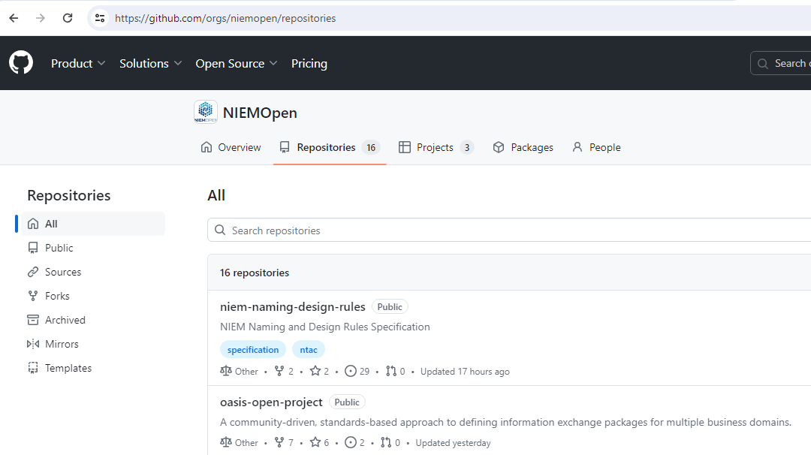
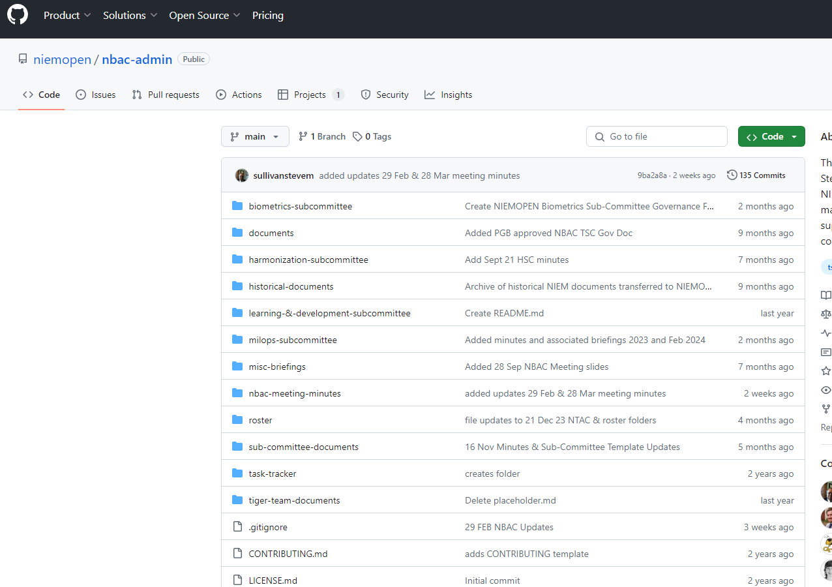
Repos
https://github.com/orgs/niemopen/repositories
NBAC Admin:
https://github.com/niemopen/nbac-admin

Slide 6








resources
Follow Us On Twitter
https://twitter.com/NIEMconnects?ref_src=twsrc%5Etfw
Katherine Escobar, katherine.b.escobar.civ@mail.mil, 7575-203-8631
Beth Smalley, beth.l.smalley.civ@mail.mil, 757-203-7177
https://www.niem.gov/
https://niemopen.org/
https://www.linkedin.com/groups/1903175/profile
Git Repos
NIEMOpen: https://github.com/niemopen/
NTAC TSC
https://github.com/niemopen/ntac-admin
NBAC TSC
https://github.com/niemopen/nbac-admin
NMO TSC
https://github.com/niemopen/nmo-admin
https://github.com/niemopen/nmo-training
NIEMOpen Slack Channel: https://niemopen.slack.com/
Mailing Lists
NIEMOpen: https://lists.oasis-open-projects.org/g/niemopen
PGB: https://lists.oasis-open-projects.org/g/niemopen-pgb
NTAC TSC: https://lists.oasis-open-projects.org/g/niemopen-ntactsc
NBAC TSC: https://lists.oasis-open-projects.org/g/niemopen-nbactsc
NMO TSC: https://lists.oasis-open-projects.org/g/niemopen-nmotsc
https://www.youtube.com/channel/UCg9qV22PXLBjG41hc-EwVrQ
MEP Registry & Repository
Restricted Repository-WMAAFIP
NIEM Message Exchange Package Builder

Slide 7
NIEMOpen Reveal
Ms. Katherine Escobar
NIEMOpen Project Governance Board Chair

Slide 8
NIEMOPEN REVEAL STATUS
NIEMOpen Reveal: Data Standard, Redefining the International Information Landscape
Purpose
Dates: 18-20 Feb 2025
Location: National Press Club, Washington DC
Venue:
Ballroom – Plenary Sessions
2 Technical Breakout Tracks (Technical Primer & Technical Expert Training Tracks)
Draft agenda available @ NBAC Admin Git Repo 28 Mar minutes folder (look there in a couple days)
PGB approved seed money to reserve Ballroom on 19 Feb
11 April PGB Motion to secure remainder of NPC facilities - Approved
How funding event:
Registration Fees
Event Sponsorship

Slide 9
28 MAR 2024 NBAC TSC Agenda
1:20 NTAC Update – Dr. Scott Renner
1:30 Communications & Outreach NMO Sub-Committee update – Paul Wormeli
1:40 Community Updates - all
1:45 Questions/Final Remarks

Slide 10
Backups

Slide 11
NIEM API and Toolbox Update
Alpha | Focus | Description | Comments
1 | Transforms | Convert [CMF or XSD] to [CMF, XSD, OWL, or JSON Schema] | Other output transformation modules should be added later (e.g., spreadsheet, CSVs, lite UML, etc.)
2 | Get model details | Get information about stewards, models, versions, namespaces, properties, types, and facets. Load NIEM 1.0 – 5.2 data. | Multi-model support for NIEM + IEPDs.
3 | Search models | Search properties and types | Code set searching should be added later.
4 | Migrate models | Migrate a supported model from one version to any later version | Runs multiple iterations in one call. Only works for models in the database with migration rules.
5 | Validate models | XML validation for XML, XSD, IEPD catalogs, XML catalogs, CMF files. NDR validation for XSD. | JSON validation and QA rules for properties and types should be added later. Reports in JSON and CSV.
6 | Infrastructure and updates | Upgrade CMF tool. Fix bugs. Update testing suites and infrastructure. Add UI for migration and validation. | Also adds better handling for structural updates to production db. Publish code and SQL.
7 | Browse UI | Browse details about NIEM and other models. Load NIEM 6.0 data, plus additional fields. | Add support for type unions, local terminology, legacy fields, and starred components.
8 | Search UI | Search properties, types, and codes
9 | Subsets | Build subsets in UI. Add SSGT wantlist to CMF transform. | New transform supports migrating users away from SSGT without losing their previous work.
10 | Model updates | Low-level functions to update the model. Add support for user permissions. | Allows other users to create models and make incremental changes.
11 | Model mgt artifacts | Load change request spreadsheets and update model. Add CMF to spreadsheet, CSV, and stats transforms. | NIEM 6.1 and future version support. Allows bulk changes via CR spreadsheet.
Feb 12, 2024
Done
In progress
To Do

Slide 12
Support for MEP Builder and to replace legacy tools
Alpha | Focus | MEP Builder | SSGT | Migration Tool | ConTesA | Movement | Model mgt
1 | Transforms | * XSD transform bug | NIEM model to XSD
2 | Get model details (API)
3 | Search models (API)
4 | Migrate models (API)
5 | Validate models (API)
6 | Infrastructure and updates | * Fix XSD transform bug |  | Add UI to Toolbox | Add UI to Toolbox
7 | Browse UI
8 | Search UI
9 | Subsets
10 | Model updates |  |  |  |  |  | Update NIEM model data; add migration rules.
11 | Model mgt artifacts |  |  |  |  |  | Load change requests. Generate version artifacts.
Done
In progress
To Do

Slide 13
Resources
Title | Link | Comments
NIEM Toolbox | https://niemopen.github.io/niem-toolbox/ | Will be available at the end of the current alpha.
NIEMOpen Tool Issue Tracker | https://github.com/orgs/niemopen/projects/4/views/2 | Kanban board for NIEM API and NIEM Toolbox. Click tabs for other groupings and views of the data.
NIEM API 2.0 code | https://github.com/niemopen/niem-api | Code to be posted at the end of the current alpha.
NIEM Toolbox code | https://github.com/niemopen/niem-toolbox | Code to be posted at the end of the current alpha.
NIEM data for the new backend PostgreSQL database | https://github.com/niemopen/niem-api-db | SQL files with NIEM 1.0 – 5.2 data to be posted at the end of the current alpha.

